Slide 1

Verifying Cyber-Physical Systems
Chapter 8 – Abstractions and Compositional Reasoning
Abenezer Taye
Nov 14, 2022

Slide 2
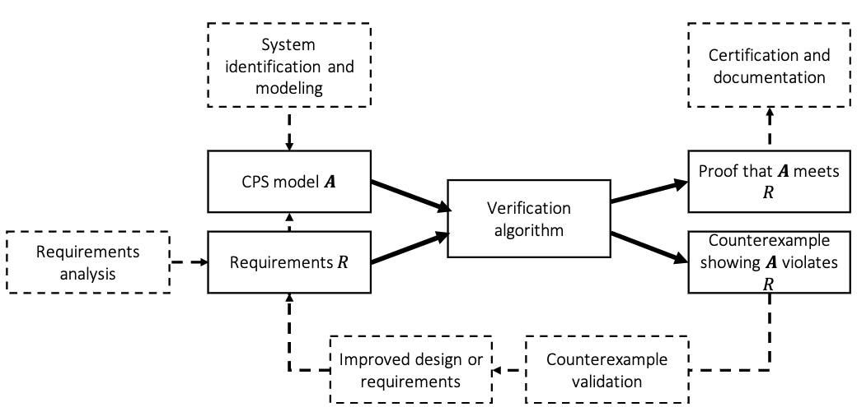
System Design Ecosystem

Slide 3
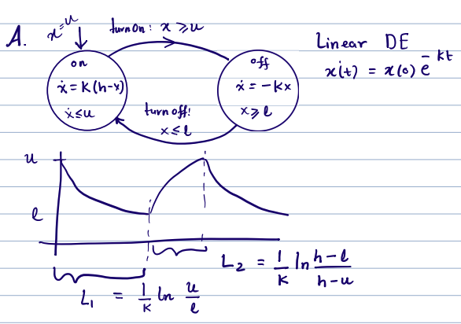
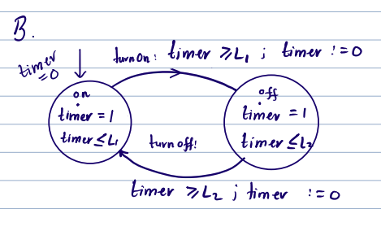
What is an Abstraction?
Thermostat Automaton
If we only care about the timing behavior of the thermostat

Slide 4
What is an Abstraction?
How can we show that B indeed has the “same” timing behavior as A?
More generally, we may only care about certain aspects of A’s executions such as
Timing
Subset of continuous variables
Control state reachability, etc.
How can we show that B is equivalent to A wrt the aspects of behavior we care about?
How can we come up with an “equivalent” B that is simpler to analyze?
Therefore, proving safety of B ➔ safety of A
unsafe
Execs B
Execs A
Mathematically, we would like to show that $∀α∈{Execs}_{A} ∃ β∈{Execs}_{B} such that α=β$
B is said to be an Abstraction of A

Slide 5
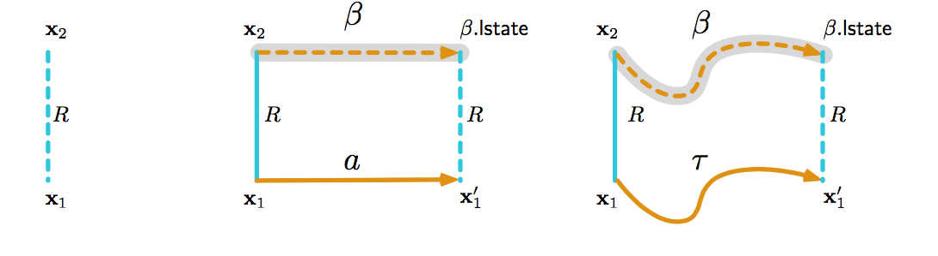
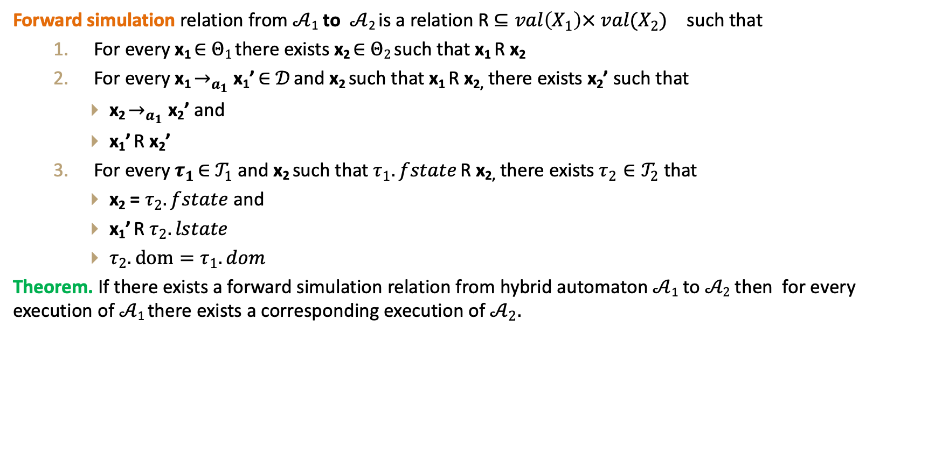
How to prove B abstracts A?
Forward simulation relation from $𝒜$₁ to $𝒜$₂ is a relation R $⊆val\left(X_{1}\right)× {val(X_{2})}_{}$ such that
For every x₁ ∈ $Θ1$ there exists x₂ ∈ $Θ2$ such that x₁ R x₂
For every x₁ $→_{a_{1}}$ x₁’ ∈ $𝒟$ and x₂ such that x₁ R x_{2,} there exists x₂’ such that
x₂ $→_{a_{1}}$ x₂’ and
x₁’ R x₂’
For every $τ_{1}$ ∈ $𝒯_{1}$ and x₂ such that $τ_{1}.fstate$ R x_{2,} there exists $τ_{2}∈𝒯_{2}$ that
x₂ = $τ_{2}.fstate$ and
x₁’ R $τ_{2}.lstate$
$τ_{2}.dom=τ_{1}.dom$
Theorem. If there exists a forward simulation relation from hybrid automaton $𝒜$₁ to $𝒜2$ then for every execution of $𝒜$₁ there exists a corresponding execution of $𝒜_{2}.$

Slide 6
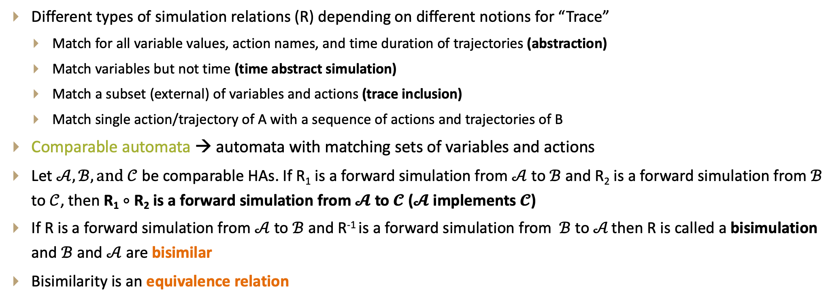
Properties of forward simulation
Different types of simulation relations (R) depending on different notions for “Trace”
Match for all variable values, action names, and time duration of trajectories (abstraction)
Match variables but not time (time abstract simulation)
Match a subset (external) of variables and actions (trace inclusion)
Match single action/trajectory of A with a sequence of actions and trajectories of B
Comparable automata → automata with matching sets of variables and actions
Let $𝒜, ℬ, and 𝒞$ be comparable HAs. If R₁ is a forward simulation from $𝒜$ to $ℬ$ and R₂ is a forward simulation from $ℬ$ to $𝒞$, then R₁ $∘$ R₂ is a forward simulation from $𝓐$ to $𝓒$ ($𝓐$ implements $𝓒$)
If R is a forward simulation from $𝒜$ to $ℬ$ and R⁻¹ is a forward simulation from $ℬ$ to $𝒜$ then R is called a bisimulation and $ℬ$ and $𝒜$are bisimilar
Bisimilarity is an equivalence relation

Slide 7
Substituting with abstractions
Concrete system
Abstract system
Plant
Controller
Plant
Abstract Controller

Slide 8
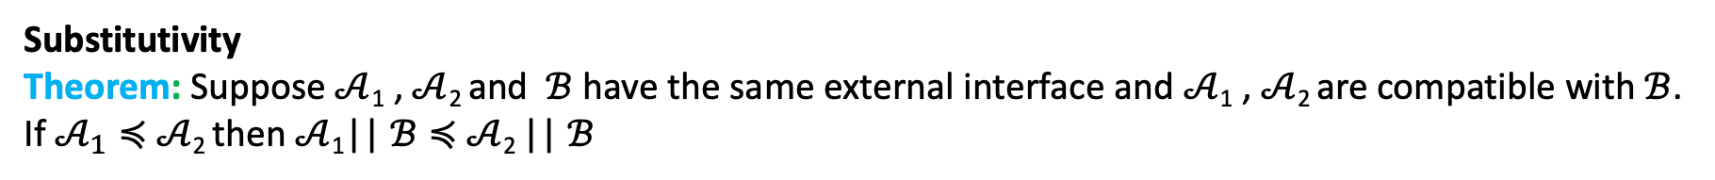


Substituting with abstractions
Controller
Abstract Controller
Does
$$≼$$
imply
Concrete system
Abstract system
Plant
Controller
$$≼$$
Plant
Abstract Controller
?
Substitutivity
Theorem: Suppose $𝒜$₁ , $𝒜$₂ and $ℬ$ have the same external interface and $𝒜$₁ , $𝒜$₂ are compatible with $ℬ$. If $𝒜_{1}≼$ $𝒜$₂ then $𝒜$₁|| $ℬ≼$ $𝒜$₂ || $ℬ$
Stronger substitutivity result
Theorem: $𝒜$₁ $||$ $ℬ_{2}≼𝒜$₂||$ℬ$₂ and $ℬ1≼ℬ2$ then $𝒜$₁ $||$ $ℬ1$ $≼𝒜$₂||$ℬ$₂.

Slide 9
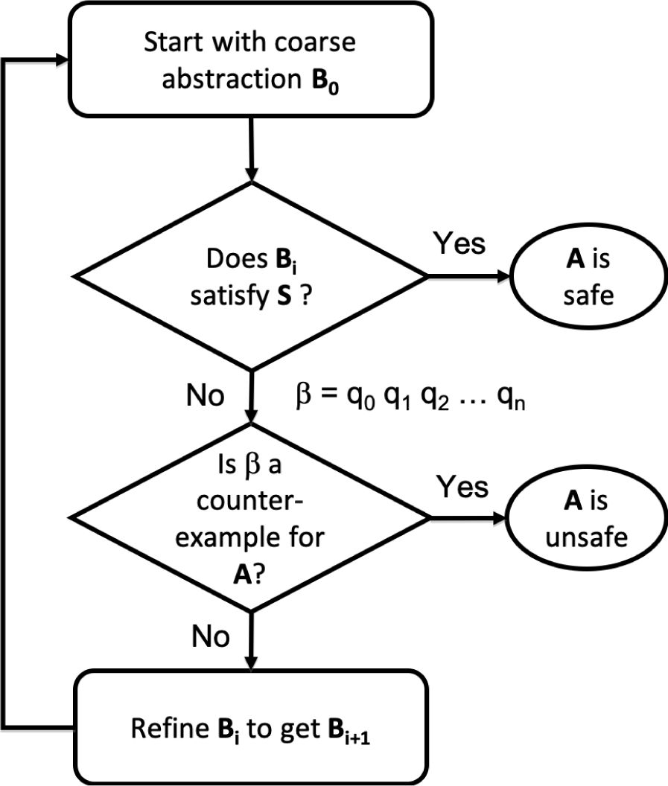
Counterexample guided abstraction refinement (CEGAR)
A general algorithmic framework for automatically constructing and verifying property-specific abstractions [Clarke:2000]
CEGAR has been applied to discrete automata, software, and hybrid systems [Holzman 00,Ball 01, Alur 2006,Clarke 2003, Fehnker2005, Prabhakar 15, Roohi 17]
The goal is to verify a requirement S for a system or an automaton A
Basic CEGAR loop for verifying a requirement S for a system A

Slide 10
Key design choices in CEGAR
Space of the abstract automata (finite, timed, linear)
Model checker for abstract automaton
Counter-example validation procedure
Refinement strategy

Slide 11
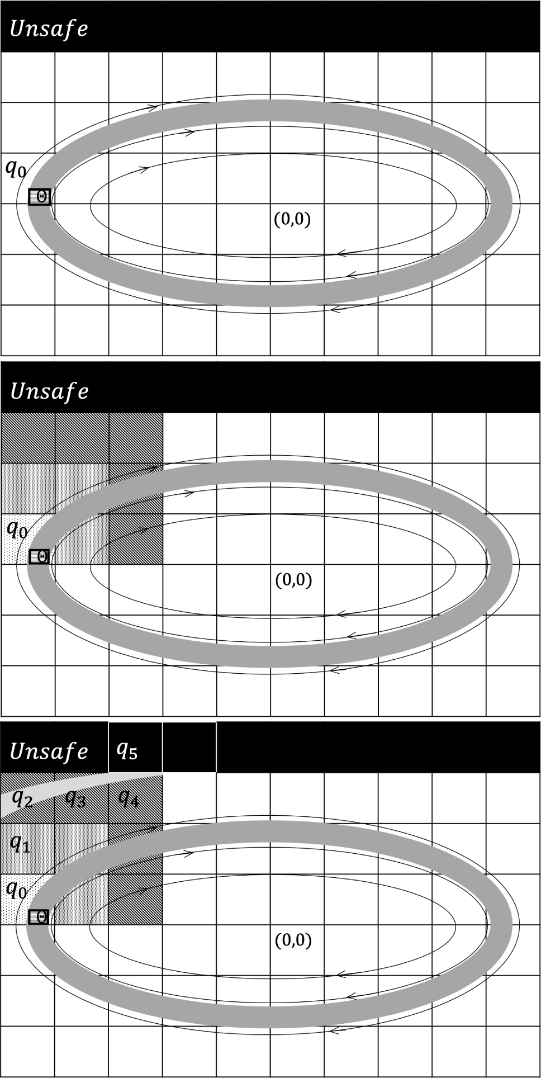
Space of the abstract automata

Slide 12
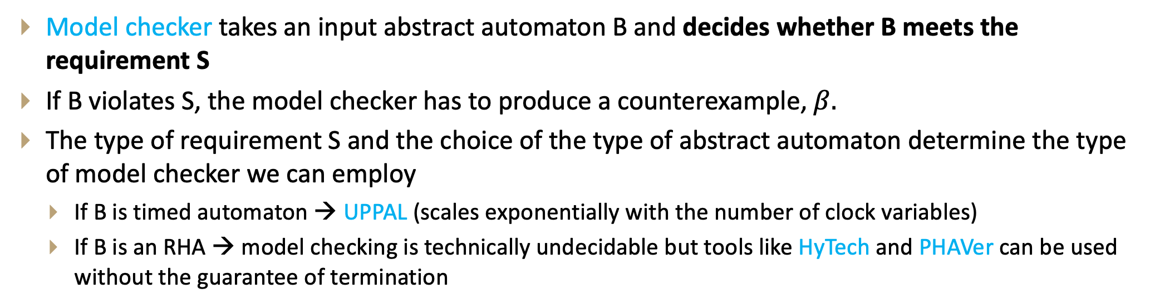
Model checker
Model checker takes an input abstract automaton B and decides whether B meets the requirement S
If B violates S, the model checker has to produce a counterexample, $β.$
The type of requirement S and the choice of the type of abstract automaton determine the type of model checker we can employ
If B is timed automaton → UPPAL (scales exponentially with the number of clock variables)
If B is an RHA → model checking is technically undecidable but tools like HyTech and PHAVer can be used without the guarantee of termination

Slide 13
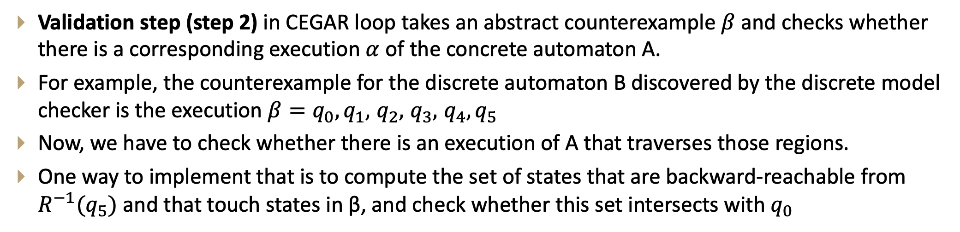
Counterexample validation
Validation step (step 2) in CEGAR loop takes an abstract counterexample $β$ and checks whether there is a corresponding execution $α$ of the concrete automaton A.
For example, the counterexample for the discrete automaton B discovered by the discrete model checker is the execution $β=q_{0},q_{1},$ $q_{2},$ $q_{3},$ $q_{4},q_{5}$
Now, we have to check whether there is an execution of A that traverses those regions.
One way to implement that is to compute the set of states that are backward-reachable from $R^{−1}(q_{5})$ and that touch states in β, and check whether this set intersects with $q_{0}$

Slide 14
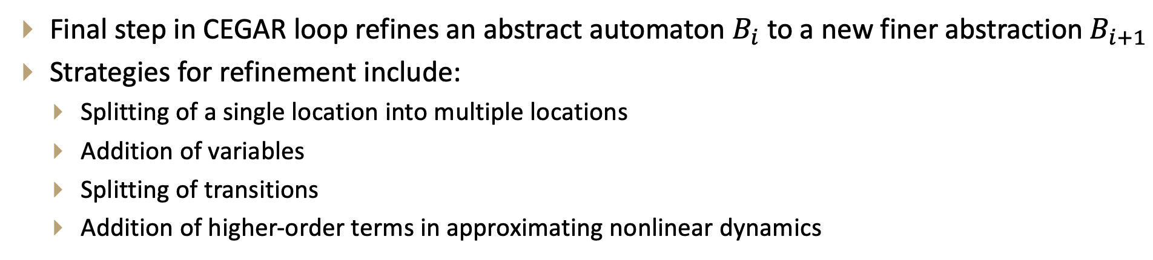
Refinement strategy
Final step in CEGAR loop refines an abstract automaton $B_{i}$ to a new finer abstraction $B_{i+1}$
Strategies for refinement include:
Splitting of a single location into multiple locations
Addition of variables
Splitting of transitions
Addition of higher-order terms in approximating nonlinear dynamics

Slide 15
Thank You!!!
Q&A

